Slide 1
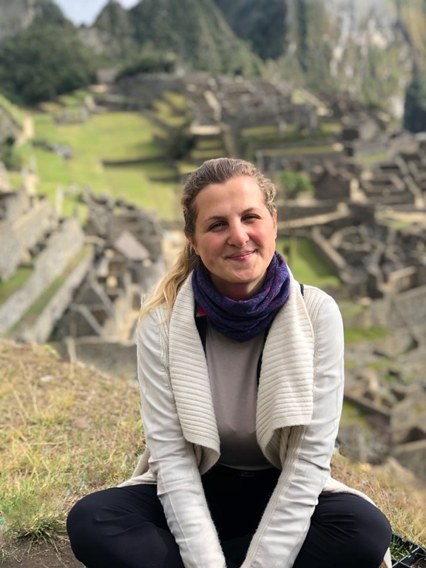





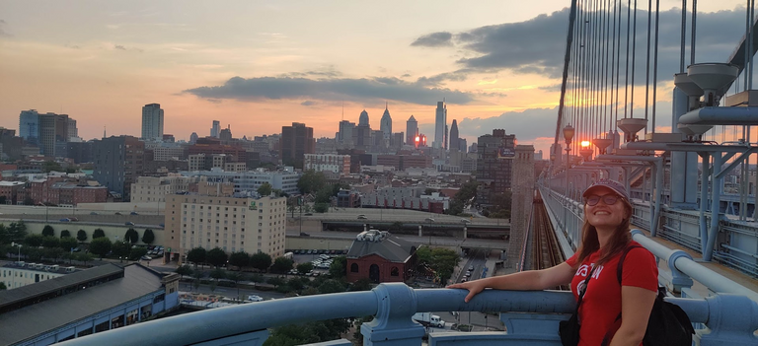
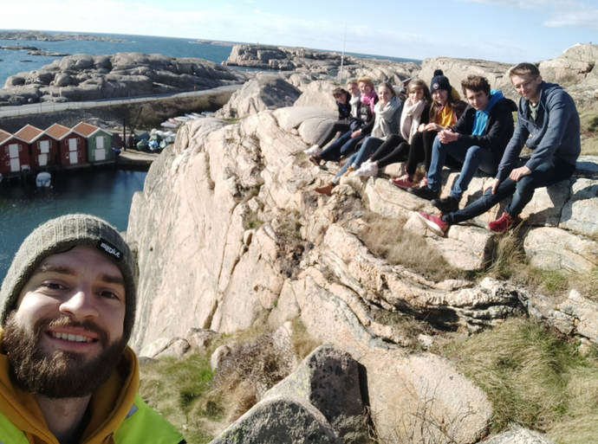
Outgoing Exchange Students
2024/25
Notes:
Přivítání
Congratulations on your study abroad prigramme
Our presentation- who we are

Slide 2
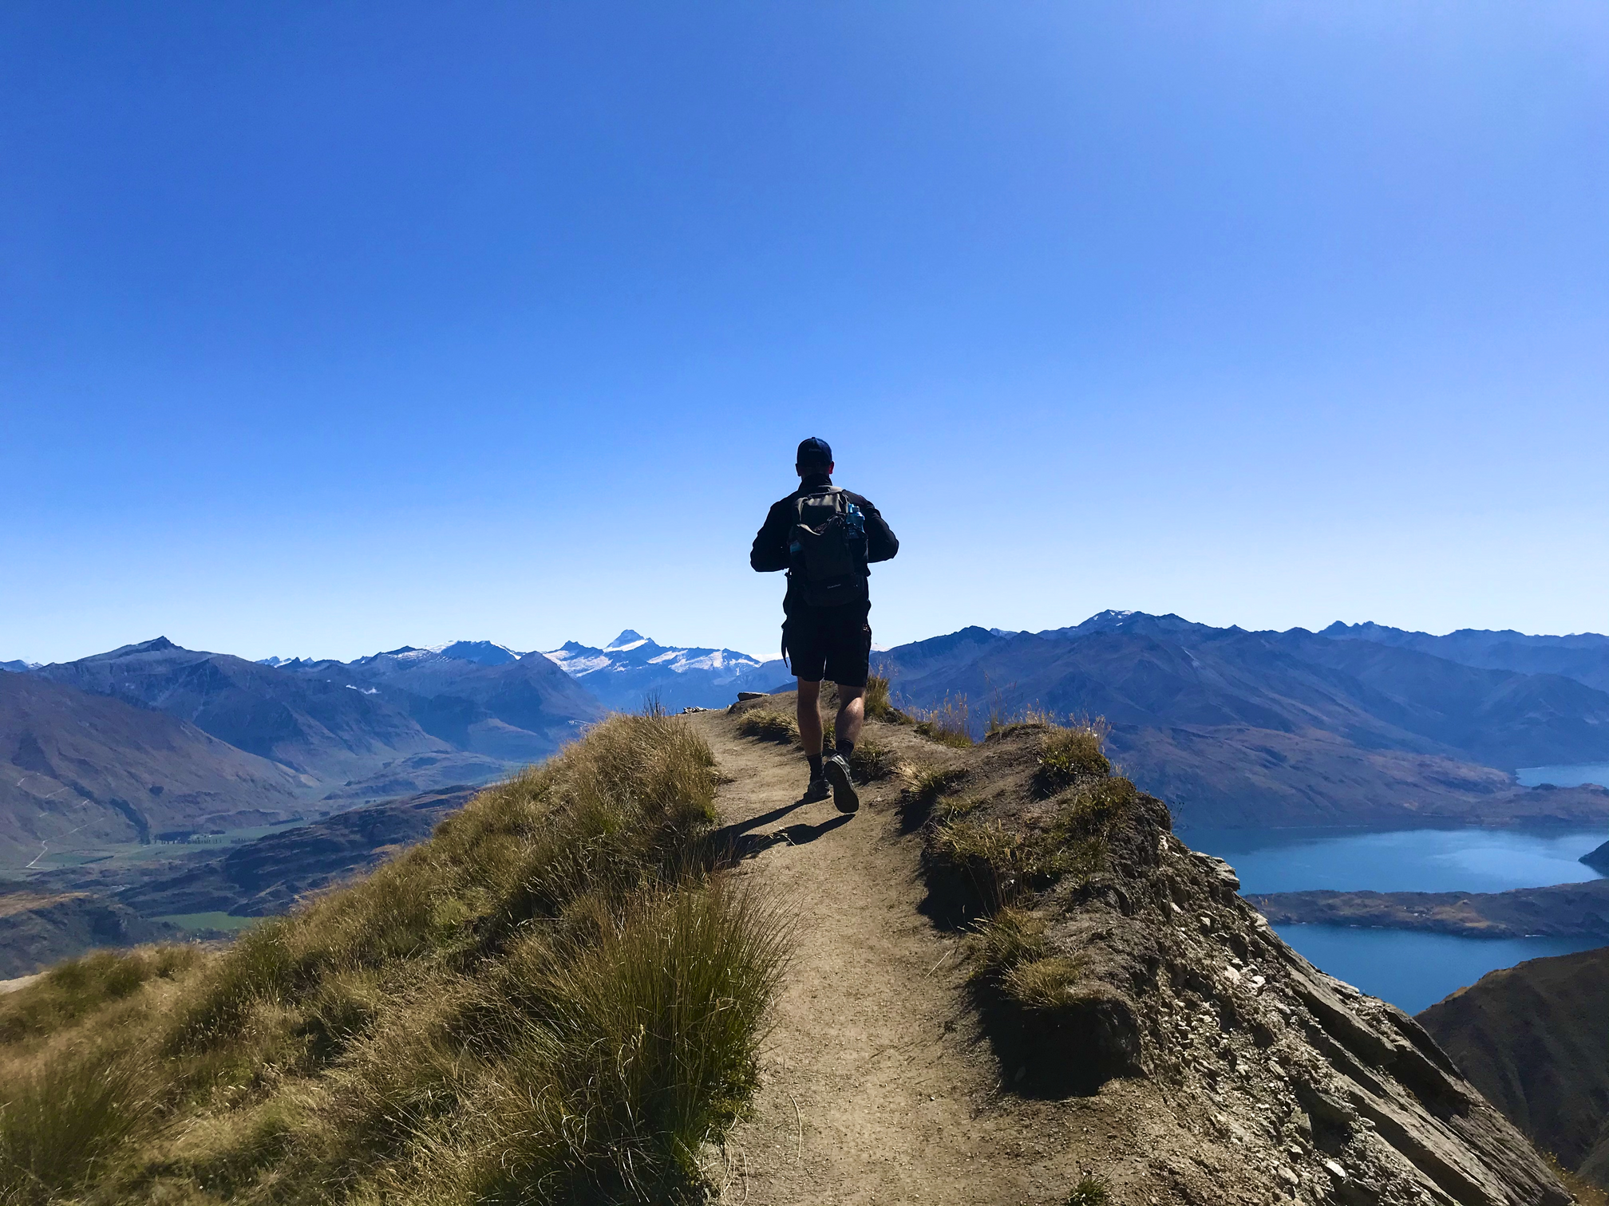
Content
Information sources
Administrative requirements
Finance
Q&A
Notes:
EK: Introduction & After the mobility procedures
KK: Before the mobility and During the Mobility procedures

Slide 3







Janka Zengerová
Barbora Minčík
Sennešová
Zuzana Manninen
Coordinators
Martina Poussin
Karolína Kaslová
Marta Slaninková
Notes:
The team of coordinators, please find your coordinator on the website.
Coordinator according to destinations.
Who goes where?
Who goes when? Fall and Spring

Slide 4








Information sources
ozs.vse.cz
Emails from the coordinators
Erasmus picker
partner university website
FB group outgoing students
final reports in InSIS
ozs@vse.cz
5th floor RB
VSE Study Abroad
consulting hours:
Mon-Thu 10:00-12:00
online every Wed 10:00-10:30
@vse_studyabroad
Notes:
Online/in person sources

Slide 5

Confirm the mobility
confirmation form in the email
a possibility to change the semester of the mobility
cancelation of the mobility
- the sooner the better
- the spot is not yours
- another spot cannot be offered
Notes:
Cancellation: if you need to cancel, no other option will be offered
You can apply again during the next academic year

Slide 6


Before mobility

Slide 7





OZS.VSE.CZ
OZS.VSE.CZ
EUROPE
OVERSEAS + SWITZERLAND
1) NOMINATION AND APPLICATION
1) NOMINATION AND APPLICATION
- Student is nominated to the partner uni by
the International Office (OZS).
- Student submits an application according
to the partner uni instructions.
- Student is nominated to the partner uni by
the International Office (OZS).
- Student submits an application according
to the partner uni instructions.
2) ONLINE LEARNING AGREEMENT
2) LEARNING AGREEMENT
- Student completes Learning Agreement
(LA), i.e. a form with courses s/he wants
to study, and uploads the signed LA into
the InSIS checklist.
- consult with your programme coordinator / academic
director at VSE
- credit conversion guide
- Student completes Online Learning Agreement
(OLA), i.e. a form with courses s/he wants to study,
and uploads the signed OLA into the InSIS checklist.
- consult with your programme coordinator / academic
director at VSE
Notes:
Nomination and Application: basically same structure
Essential to meet the deadline
OLAxLA in InSIS

Slide 8





OZS.VSE.CZ
OZS.VSE.CZ
EUROPE
OVERSEAS + SWITZERLAND
3) ACCEPTANCE LETTER
3) ACCEPTANCE LETTER
- Student receives a confirmation of admission.
- Student uploads a copy of the acceptance
letter/e-mail into the InSIS checklist.
- Student receives a confirmation of admission.
- Student uploads a copy of the acceptance
letter/e-mail into the InSIS checklist.
4) EMERGENCY CONTACT
4) EMERGENCY CONTACT
4) EMERGENCY CONTACT
- Student fills in the emergency contact details.
- Student fills in the emergency contact details.
5) GRANT AGREEMENT
5) FLIGHT TICKET
- Prepared by OZS after student fulfilled the
steps above.
- Usually signed in person at OZS.
- Students upload a copy of their flight ticket
into the InSIS checklist.
6) PAY TUITION FEE AT VSE
6) PAY TUITION FEE AT VSE
- note in student´s evidence in InSIS
- note in student´s evidence in InSIS
Notes:
Acceptance Letter may serve for VISA purposes, may be sent in paper version: correct delivery address in InSIS
Emergency contact – through form
Overseas and Switzerland do not sign grant agreement

Slide 9




OZS.VSE.CZ
OZS.VSE.CZ
EUROPE
OVERSEAS
7) FINANCE
7) FINANCE
10 000 CZK / MONTH
+ 10 000 CZK ONE-OFF GRANT FOR AIR
TICKET/VISA
660 € / MONTH
Austria, Belgium, Denmark, Finland, France, Germany, Iceland, Ireland, Italy, Lichtenstein, Luxembourg, Netherlands, Norway, Sweden, United Kingdom
600 € / MONTH
SWITZERLAND
Cyprus, Estonia, Greece, Lithuania, Malta, Portugal, Slovakia, Slovenia, Spain
600 € / MONTH
540 € / MONTH
Swiss-European Mobility Programme Scholarship (440 CHF / month)
+ possible supplementary scholarship from VSE
Bulgaria, Croatia, Hungary, Latvia, Macedonia, Poland, Romania, Turkey
Notes:
Finance: no tuition fees at the partner institution, sometimes 20.000 EUR/semester
Pays tuition fee to VSE
Scholarship: to a Czech bank account (=with a Czech bank)
Own resources necessary

Slide 10




OZS.VSE.CZ
OZS.VSE.CZ
EUROPE
OVERSEAS + SWITZERLAND
EXTRA FUNDING
EXTRA FUNDING
- Additional funding for students with physical, mental or health-related conditions
- Special grant for students from disadvantaged socio-economic backgrounds
- Other study abroad funding options
8) PRACTICAL INFORMATION
8) PRACTICAL INFORMATION
- Visa and insurance are student´s responsibility.
- Student makes her/his accommodation arrangements on her/his own.
- Visa and insurance are student´s responsibility.
- Student makes her/his accommodation arrangements on her/his own.
For useful tips and more information check the students' reports in InSIS.
For useful tips and more information check the students' reports in InSIS.
Notes:
Non EU citizens make sure that Czech residence permit covers the whole period abroad

Slide 11

During mobility

Slide 12



OZS.VSE.CZ
OZS.VSE.CZ
EUROPE
OVERSEAS + SWITZERLAND
1) REPRESENTATION AT PARTNER UNIVERSITY
1) REPRESENTATION AT PARTNER UNIVERSITY
- Student represents VSE at study abroad
events organized by partner uni.
- Promotional materials can be requested
from the International Office (OZS).
- social media
- Student represents VSE at study abroad
events organized by partner uni.
- Promotional materials can be requested
from the International Office (OZS).
- social media
2) ONLINE LEARNING AGREEMENT (OLA)
2) LEARNING AGREEMENT (LA)
- In case of course changes, student fills in the
OLA During Mobility.
- Student uploads the duly signed OLA During
Mobility into the InSIS checklist.
- In case of course changes, student fills in the
LA During Mobility.
- Student uploads the duly signed LA During
Mobility into the InSIS checklist.
Notes:
Some partner univerrsities require representation, think what you wished to know and learn these facts about VSE

Slide 13

After mobility

Slide 14


OZS.VSE.CZ
OZS.VSE.CZ
EUROPE
SWITZERLAND
1) CONFIRMATION OF STUDY PERIOD
1) CONFIRMATION OF STUDY PERIOD
- It is necessary to comply with the length of
stay, its purpose and gain required nr. of credits.
- Mobility dates must be confirmed in the form.
- Student uploads a copy of the form into the
InSIS checklist and delivers the ORIGINAL
to the International Office.
- It is necessary to comply with the length of
stay, its purpose and gain required nr. of credits.
- Mobility dates must be confirmed in the form.
- Student uploads a copy of the form into the
InSIS checklist and delivers the ORIGINAL
to the International Office.
2) FINAL REPORTS ON STAY ABROAD
2) FINAL REPORT ON STAY ABROAD
- Student fills in the report in InSIS.
- Link to the report in the EU database
is sent to the student's email.
- Student fills in the report in InSIS.
- The report shloud be filled in details, because
it serves as an information source for future
outgoing students.
Notes:
Pozor, nahoře je jen Švýcarsko
Confirmation: by host university (can also be delivered by email from the host university directly)
EU: in InSIS & Beneficiary Module
Swizerland: InSIS only

Slide 15


OZS.VSE.CZ
OZS.VSE.CZ
EUROPE
OVERSEAS + SWITZERLAND
3) TRANSCRIPT OF RECORDS
3) TRANSCRIPT OF RECORDS
- Transcript is issued by partner uni 1-3 months
after the end of the mobility.
- Student uploads a copy of the transcript
into the InSIS checklist.
- Transcript is issued by partner uni 1-3 months
after the end of the mobility.
- Student uploads a copy of the transcript
into the InSIS checklist.
4) TRANSFER OF CREDITS
4) TRANSFER OF CREDITS
- Student applies for a transfer of credits in InSIS.
- Transfer of credits and results is mandatory and
all courses must be recognized in full.
- Student applies for a transfer of credits in InSIS.
- Transfer of credits and results is mandatory and
all courses must be recognized in full.
Notes:
All countries same process

Slide 16
doc. Ing. Marcela Zárybnická Žárová, CSc.
(Vice-dean for international relations)
Transfer of credits
MIFA
IBB
IDS
IB
Ing. O. Sankot, Ph.D.
(Vice-dean for education and development)
- you received a transcript
- guide at the OZS website
- by the end of the semester following your mobility
BBA
CEMS
MIMG
doc. Ing. L.Tyll, MBA, Ph.D.
(Academic director)
EDA
ISM
Ing. K. Vltavská, Ph.D.
(Vice-dean for academic affairs)
ECON
EPP
Ing. A. Zubíková, Ph.D.
(Vice-dean for academic affairs)

Slide 17

Questions?

